Slide 1
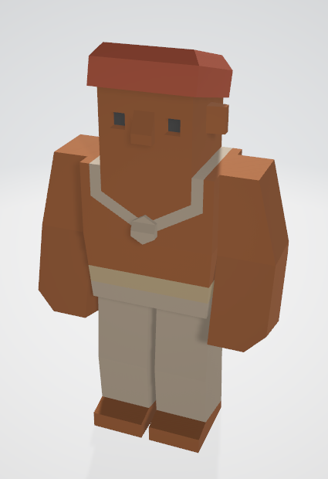
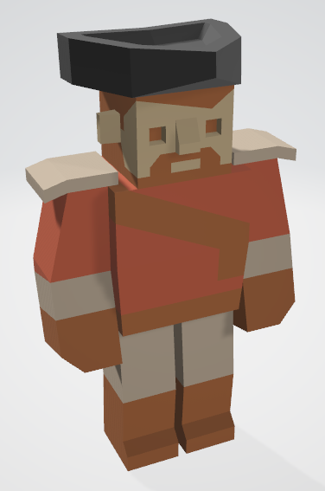
Level 6 – Group 3
Ship Happens
Tom Gibbs
Henry Crofts

Slide 2
The Game
Screen mocks ups

Slide 3
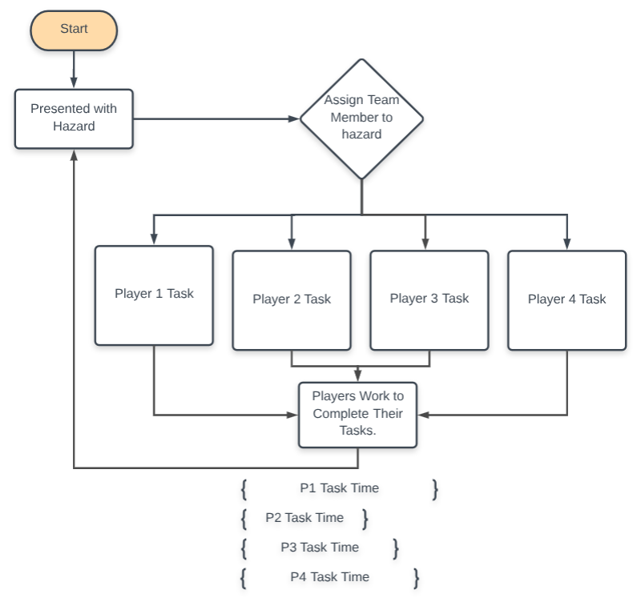
Flow Chart

Slide 4
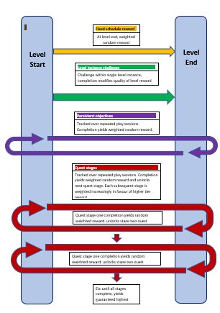
Reward Schedules

Slide 5
Milestones for Minimum Viable Product
Balancing
Code structure, interfaces
Player movement and interaction by (DATE)
UI
Action logic in objects
Player select and customisation (Placeholder assets)
Rewards
Tutorial paced correctly
Playtesting
Extra mechanics if not hard enough

Slide 6
Maze Game
Networked coop puzzle game where teams of two players must coordinate to reach the centre of the maze before the opposing team, avoiding traps and collecting power ups to aid their team or hinder the other
PC / Console
18 - 35 years old males

Slide 7
Maze Game – Game loop
Assess Arena
Communicate with team
Increase your teams victory opportunity / reduce opponents
Work towards solution

Slide 8
Maze Game - Audience
Psychographic – 18-35 year old male, competitively minded, looking to play sporadically
Social Achievers
People fun
Hard fun
Game pleasures – challenge, fellowship

Slide 9
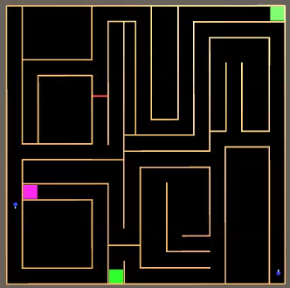
Maze Game - Prototype

Slide 10
Maze Game - Project
Risks: level design, visual assets, playtesting
Mitigate
Schedule

Slide 11
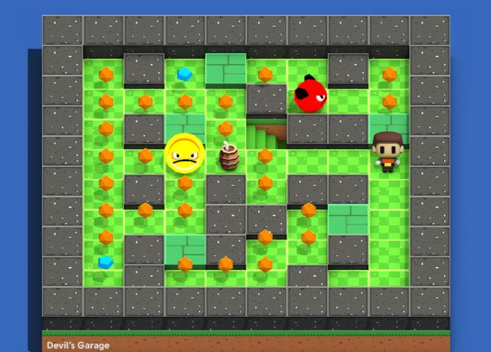
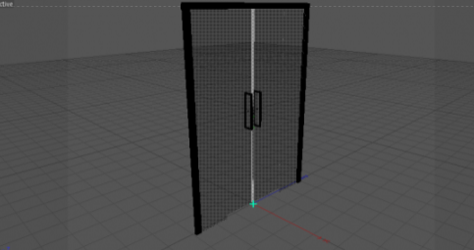
Maze Game – Asset Risks

Slide 12
Management Game
Local coop resource management game where players must coordinate to resolve hazards and manage activities, figuring out the optimal strategy
PC / Console
13 – 24 year old
Assess problem
Communicate with team
Increase pressure, cause panic
Survive
(survive level, earn upgrade/reward)
Work towards solution
Notes:
From silimar games demographic of: 13 – 24 (teen – young adult)

Slide 13
Management Game - Audience
Psychographic – 13–24yo male, frequently has visitors, focused and goal oriented
Skill level
Social Achievers
Hard fun, people fun, serious fun
Notes:
13 – 24 (teen – young adult) jesse schell
Men tend to enjoy more skill based games, low skill level required to encourage players, but a high skill ceiling to appeal to men
Jesse schell: 5 things men tend to like: Mastery, Completion, Destruction, Spatial puzzles, trial and error
our psycographic is 16-25M, frequent guests, competitively minded,we have tried to design a mechanic where ntry requires a low skill level, but as men tend to favour skill based games, has a high level of mastery - high skill ceiling,ass a social achiever our psycographic would value people fun + hard fun - so we want them to experience cooperation, communication, obstacles, strategies, goals to experience amusement, admiration, frustration, relief and fiero

Slide 14
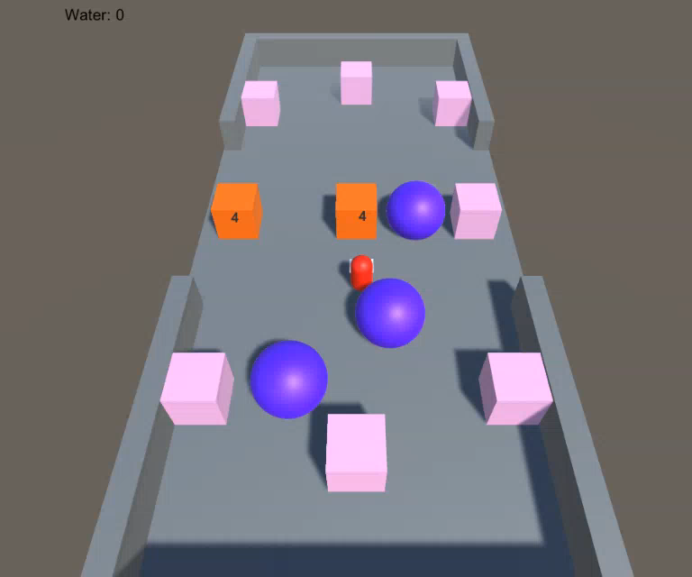
Management Game - Prototype

Slide 15
Management Game - Project
Risks: level design, visual assets, telegraphing, playtesting
Mitigate
Schedule
Notes:
Schedule:
Implementation of essential mechanics
Series of playtest round
Based on feedback, fully implement essential mechanics/UI by Christmas
Inclusion of improved assets by end of February
Confirm through playtesting suitability of relationship between visual assets and code
Polish until project end

Slide 16

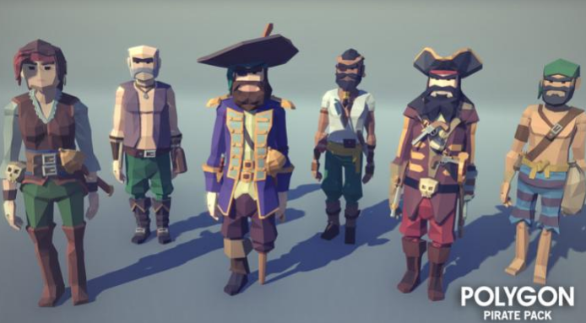
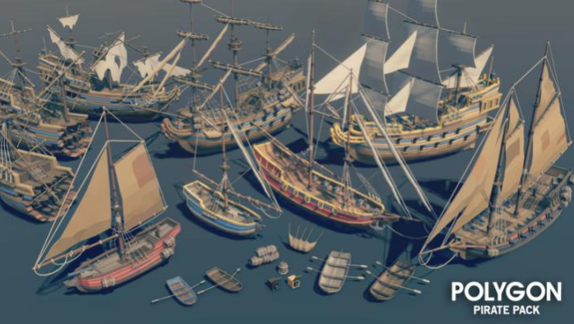
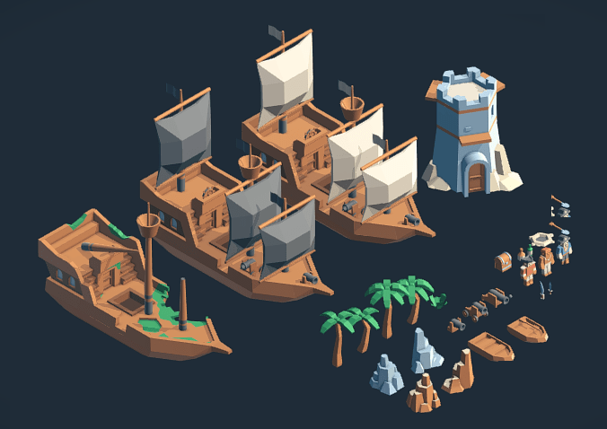
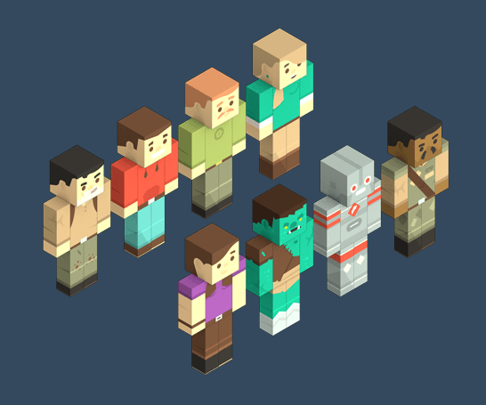
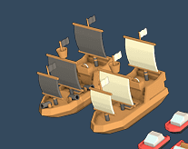
Management Game – Primary Risk

Slide 17
Tether Game
Local coop physics game where players must effect movement through interaction with their partner to progress through the level, avoiding hazards and gathering collectibles
PC / Console
13 – 24 years old, male
Notes:
Adios Amigos – 2D coop space physics exploration

Slide 18
Tether Game – Game loop
Assess problem
Communicate with team
Progress through level
(Complete level to unlock new challenges,
new tools)
Work towards solution

Slide 19
Tether Game - Audience
Psychographic – 13–24yo male, enjoys playing with friends, forward planner, good communication
Relatively high skill level
Social Achiever (people fun and hard fun)
People fun, serious fun, hard fun

Slide 20
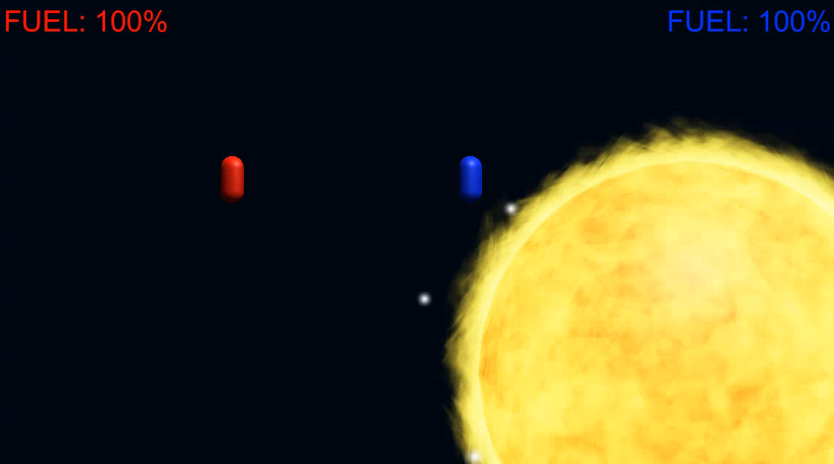
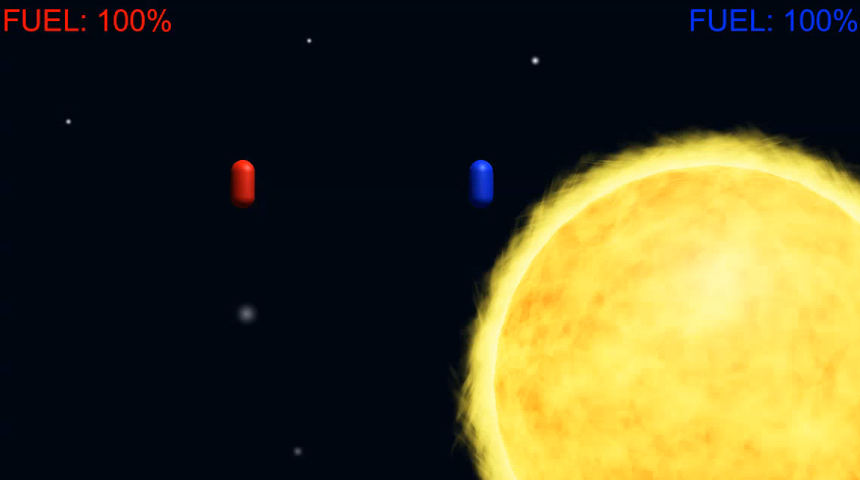
Tether Game - Prototype

Slide 21
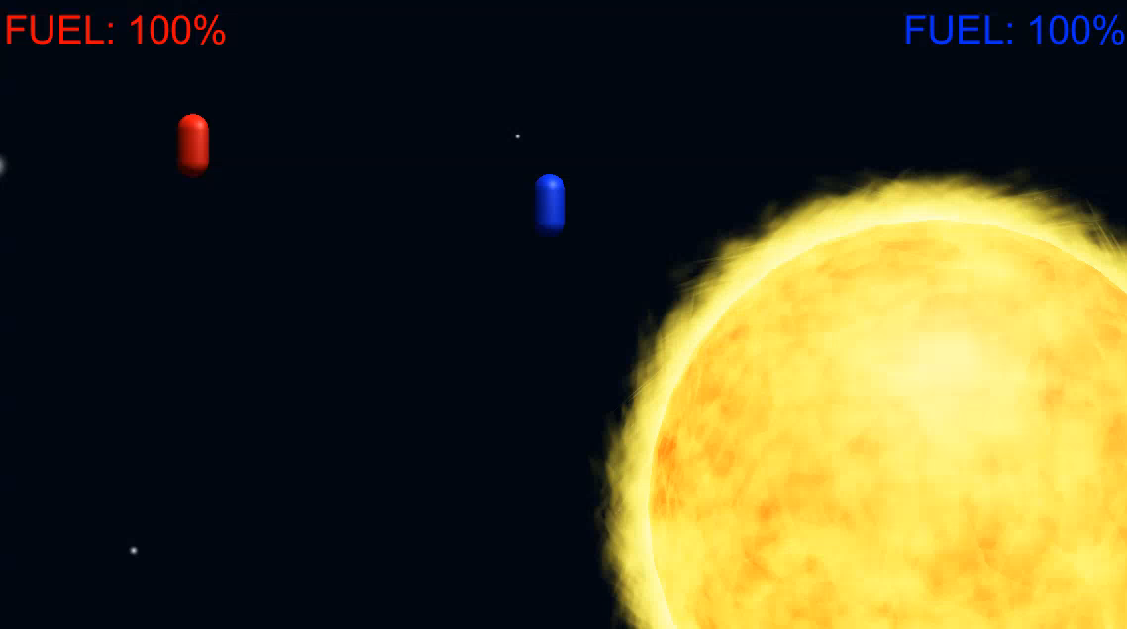
Tether Game - Prototype

Slide 22
Tether Game - Project
Risks: level design, visual assets, telegraphing, playtesting
Mitigate
Schedule

Slide 23
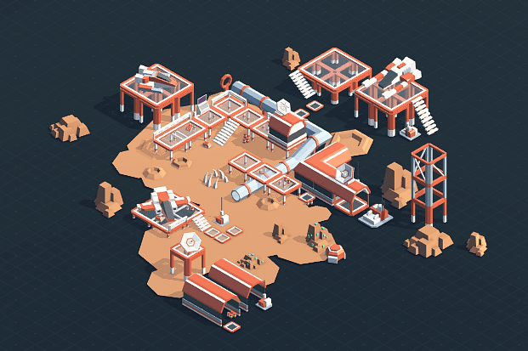

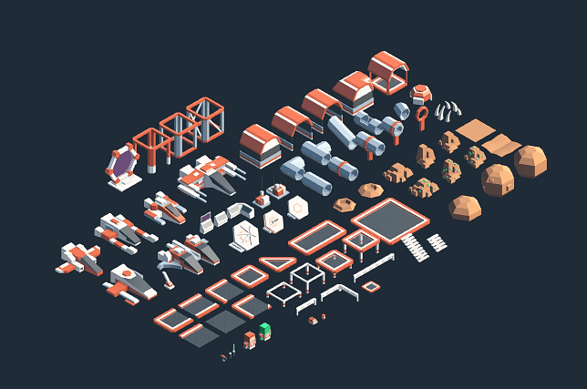

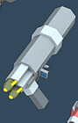
Tether Game - Risks

Slide 24
Questions?
Notes:
Jesse Schell, the art of design (demograpphics)
Bartle's Taxonomy of Player Types – tutsplus (2013)
- Gamified (2013)
Nicola lazarro
LeBlanc’s Taxonomy of Game Pleasures
Flow state anxiety/boredom

